Slide 1
Transaction Management

Slide 2
Introduction
Time sharing systems executes more than one program at the same time by interleaving the execution of the programs
In DBMS, we consider transactions, not programs
A transaction is a database program that must be completed entirely in order to retain the consistency of the database; if the transaction cannot be completed, the database should remain at the same state as if the transaction hadn’t been executed at all
Concerned only with interleaved execution of transactions
If the database is initially in consistent state (or empty), a sequence of transactions would bring the database from one consistent state to another
Notes:
2
2

Slide 3
Assumptions and Basic Operations
A database is a set of data items accessed and modified by transactions
A transaction accesses or modifies the contents of a database
read_item(X) or R(X): Reads a database item X
write_item(X) or W(X): Writes a value into the database item X
Additional operations:
Commit - the transaction is successful and the data items value must be changed (if any) on the database permanently
Rollback/Abort - the transaction is not successful, do not change any of the data item values
BEGIN_TRANSACTION, END_TRANSACTION
DBMS may need UNDO and REDO for database recovery
Notes:
2
2

Slide 4
Transactions
Transactions are not just ordinary programs
Additional requirements are placed on transactions (and particularly their execution environment) that go beyond the requirements placed on ordinary programs.
Atomicity
Consistency
Isolation
Durability
ACID properties

Slide 5
ACID Properties
Atomicity
All-or-nothing property
Consistency
Each transaction is correct and does not violate database consistency
Isolation
Concurrent transactions do not interfere with each other
Durability
Once the transaction completes its work (commits), its effects are guaranteed to be reflected in the database regardless of what may occur

Slide 6
Consistency
A database state consists of the complete set of data values in the database
A database state is consistent if the database obeys all the integrity constraint
A transaction brings the database from one consistent state to another consistent state
Database in a consistent state
Database may be temporarily in an inconsistent state during execution
Database in a consistent state
Begin Transaction
Execution of Transaction
End Transaction
Notes:
2
2

Slide 7
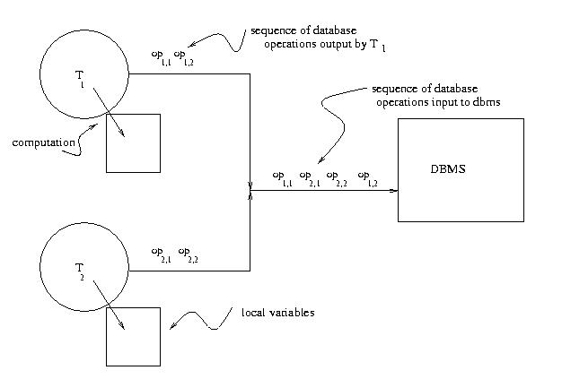
Concurrent Transaction Execution

Slide 8
Transaction Concept
A transaction is a unit of program execution that accesses and possibly updates various data items.
E.g. transaction to transfer $50 from account A to account B:
1. read(A)
2. A := A – 50
3. write(A)
4. read(B)
5. B := B + 50
6. write(B)
Two main issues to deal with:
Failures of various kinds, such as hardware failures and system crashes
Concurrent execution of multiple transactions

Slide 9
Example of Fund Transfer
Transaction to transfer $50 from account A to account B:
1. read(A)
2. A := A – 50
3. write(A)
4. read(B)
5. B := B + 50
6. write(B)
Atomicity requirement
if the transaction fails after step 3 and before step 6, money will be “lost” leading to an inconsistent database state
Failure could be due to software or hardware
the system should ensure that updates of a partially executed transaction are not reflected in the database
Durability requirement — once the user has been notified that the transaction has completed (i.e., the transfer of the $50 has taken place), the updates to the database by the transaction must persist even if there are software or hardware failures.

Slide 10
Example of Fund Transfer (Cont.)
Transaction to transfer $50 from account A to account B:
1. read(A)
2. A := A – 50
3. write(A)
4. read(B)
5. B := B + 50
6. write(B)
Consistency requirement in above example:
the sum of A and B is unchanged by the execution of the transaction
In general, consistency requirements include
Explicitly specified integrity constraints such as primary keys and foreign keys
Implicit integrity constraints
e.g. sum of balances of all accounts, minus sum of loan amounts must equal value of cash-in-hand
A transaction must see a consistent database.
During transaction execution the database may be temporarily inconsistent.
When the transaction completes successfully the database must be consistent
Erroneous transaction logic can lead to inconsistency

Slide 11
Example of Fund Transfer (Cont.)
Isolation requirement — if between steps 3 and 6, another transaction T2 is allowed to access the partially updated database, it will see an inconsistent database (the sum A + B will be less than it should be). T1 T2
1. read(A)
2. A := A – 50
3. write(A) read(A), read(B), print(A+B)
4. read(B)
5. B := B + 50
6. write(B
Isolation can be ensured trivially by running transactions serially
that is, one after the other.
However, executing multiple transactions concurrently has significant benefits, as we will see later.

Slide 12
States of a Transaction
Begin
transaction
Read/Write
End
transaction
Partially
committed
commit
committed
active
abort
abort
rollback
failed
terminated
Active: transaction is started and is issuing reads and writes to the database
Partially committed: operations are done and values are ready to be written to the database
Committed: writing to the database is permitted and successfully completed
Failed: the transaction or the system detects a fatal error
Terminated: transaction leaves the system(Aborted)
Notes:
2
2

